Slide 1

ADMIN MODULE WEB BASED APPLICATION
PRESENTED BY :
A. RATNAKUMAR
R. HARI NARAYANAN
MITTA VAMSI
PRADEEP
SRI SUDHARSHAN
,
NAME OF THE PROGRAMME MANAGER:
MR. AMARENDRA AMIREDDY

Slide 2
OUTLINE
ABSTRACT
OBJECTIVE
ARCHITECTURE
MODULES
IMPLEMENTATION
OUTPUT
SECURITY ENHANCEMENTS
CONCLUSION
REFERENCES

Slide 3
ABSTRACT
The Admin Module is a crucial component of a software system that provides administrative functionalities and privileges to authorized users.
It is designed to manage and control various aspects of the system, allowing administrators to perform tasks such as user management, data management, and monitoring.
The abstract of the Admin Module describes the high-level overview and functionality of the module without delving into specific implementation details.

Slide 4
OBJECTIVE
The objective of the Admin Module is to provide a centralized platform and tools for efficient administration and management of a software system
The Admin Module ultimately aims to enhance productivity and security while enabling administrators to effectively control and oversee the software system.

Slide 5


TECHNOLOGY STACK
Front-End :
HTTP Client Module
Back-End :

Slide 6
ARCHITECTURE DESIGN
Admin
Dashboard
Login /
Register
( Valid )
Admin
View / Edit
Delete
Database
Records
Login /
Register
( InValid )

Slide 7
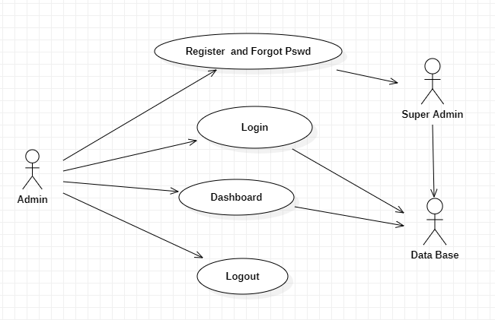
UML :- Use Case Diagram

Slide 8
MODULES AND IT’S DESCRIPTION
Login / Registration
Forgot Password
Employee Details (CRUD)
View
Edit
Delete
Delete All
Count

Slide 9
MODULES AND IT’S DESCRIPTION
Admin Details
View
Search By Anything
Filter the Data
Export the Data into CSV
Data Entry in Sheet
Logout

Slide 10
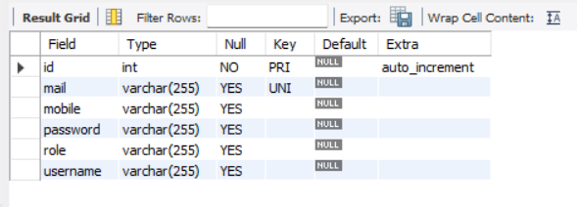
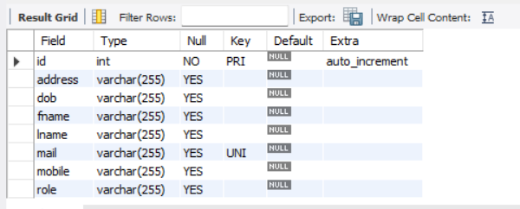
IMPLEMENTATION
DB Structure :
Admin
Employee

Slide 11
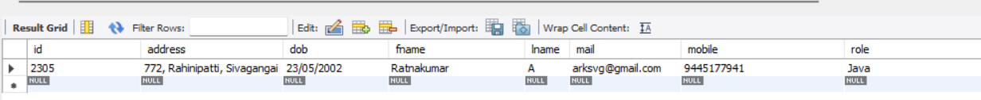
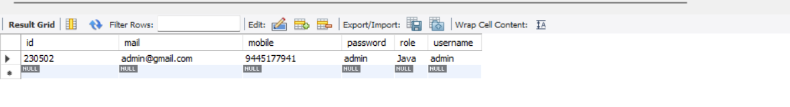
IMPLEMENTATION
DB Schema :
Employee - Table
Admin - Table

Slide 12
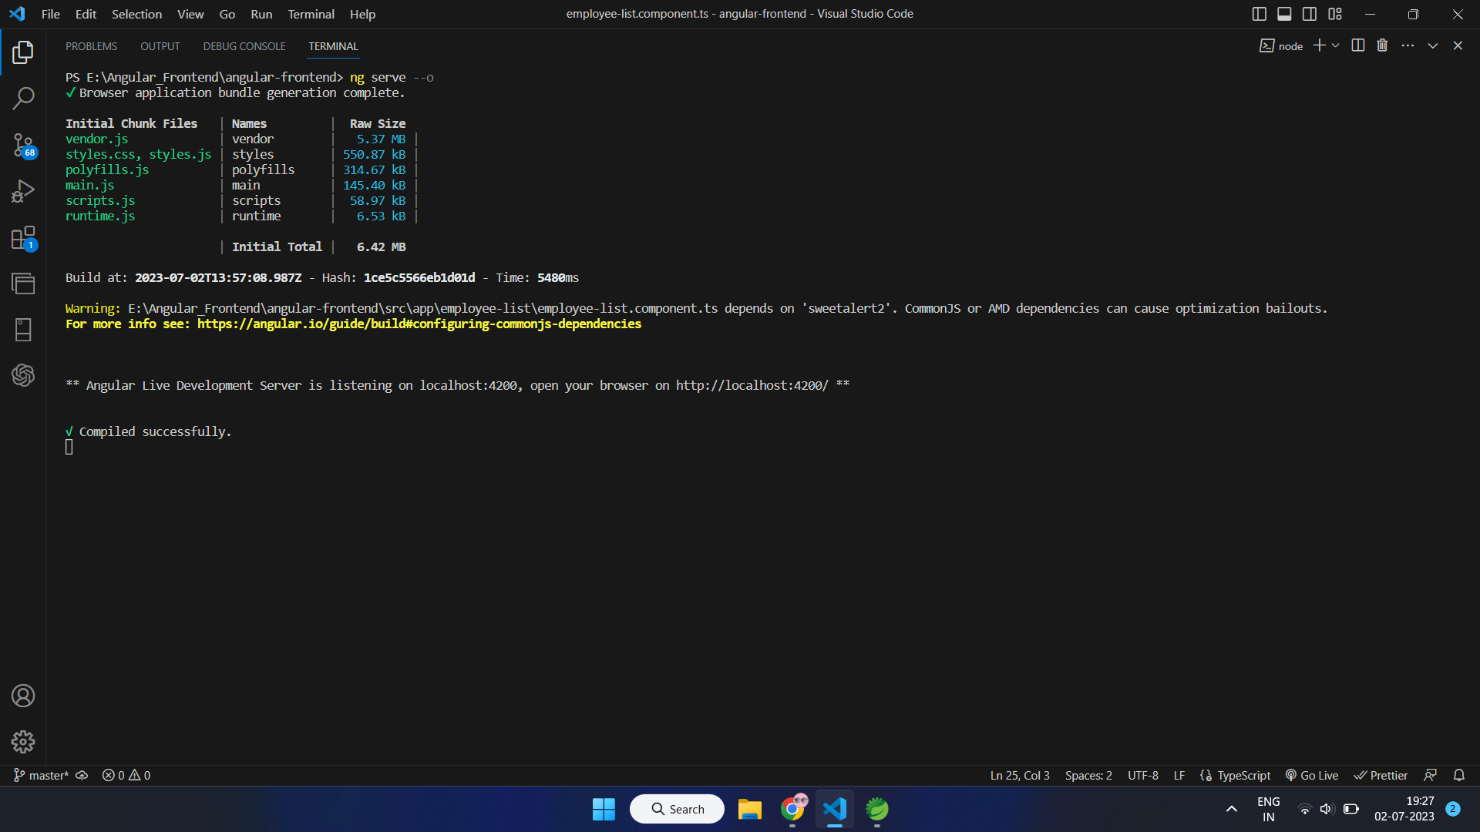
Server Deployment:
Front-End :

Slide 13
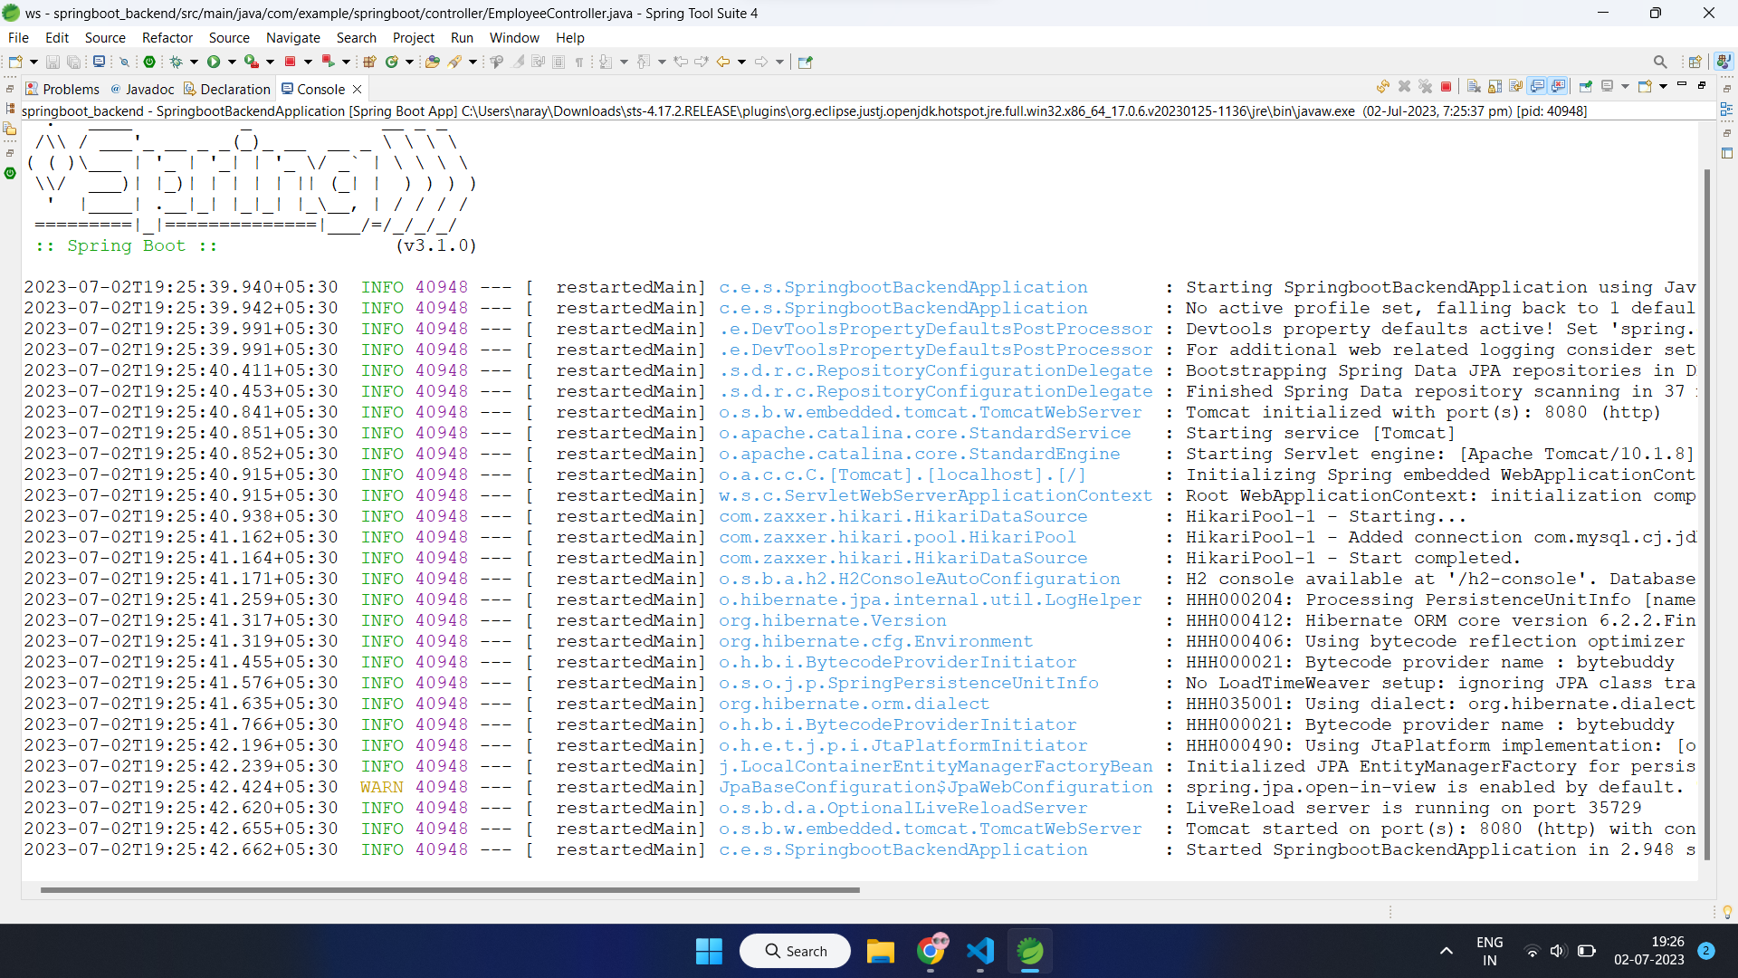
Server Deployment :
Back-End :

Slide 14
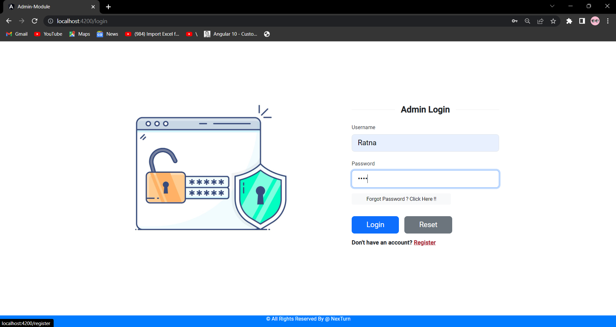
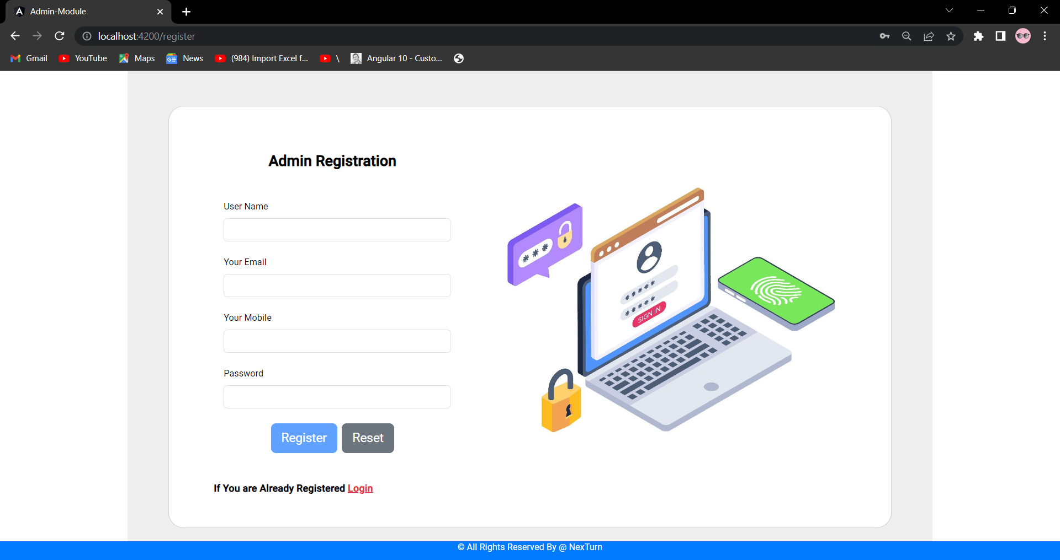
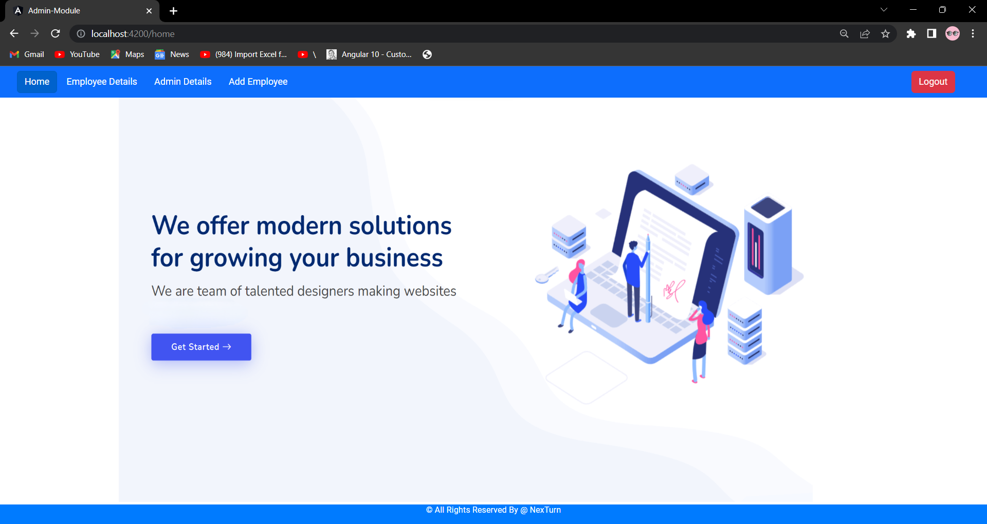
OUTPUT

Slide 15
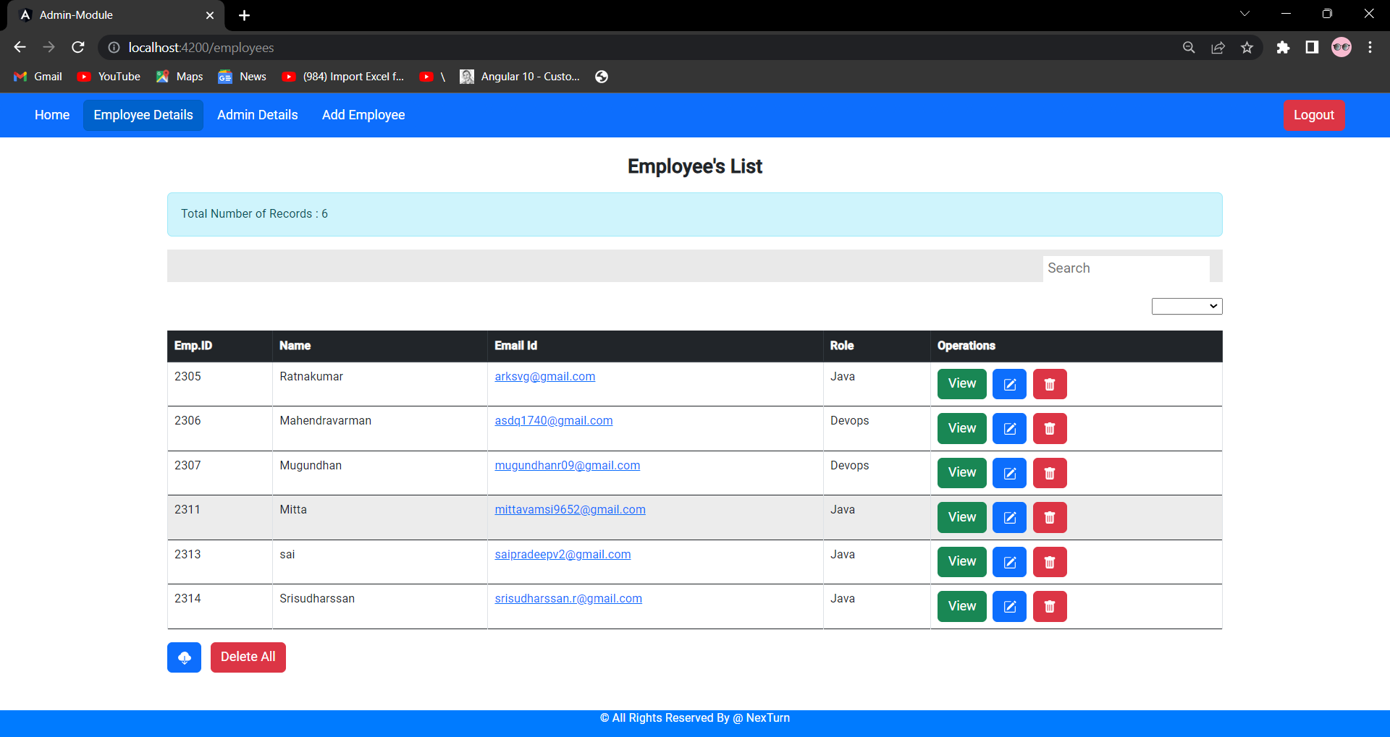
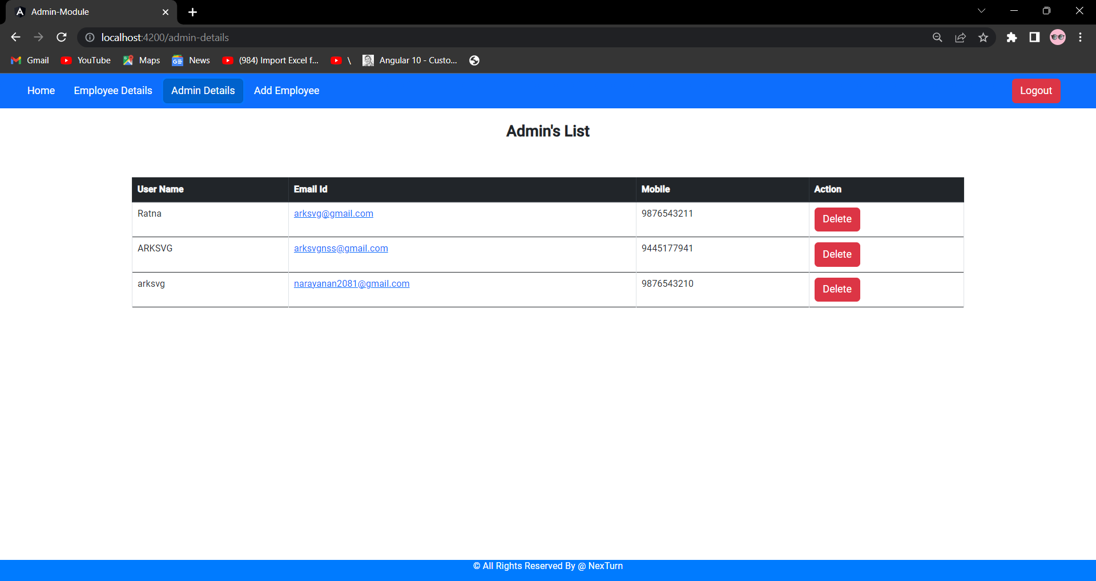
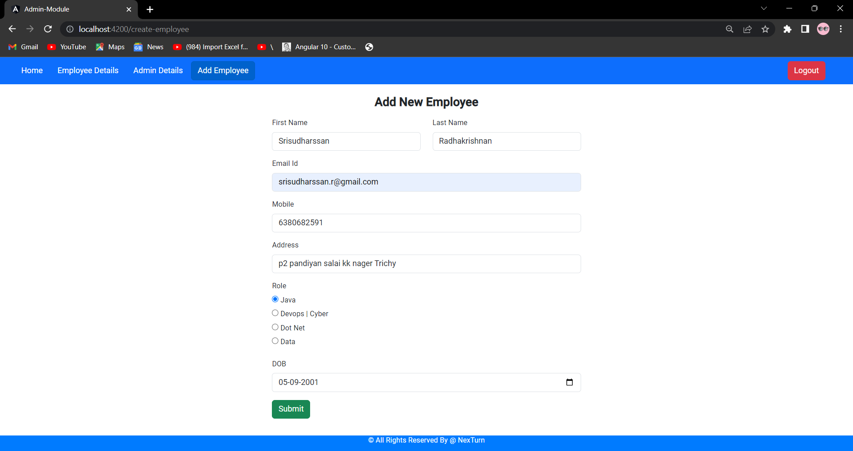

Slide 16
SECURITY ENHANCEMENTS
SQL Injection Bypass - SQL injection is a serious security vulnerability that can lead to unauthorized access.
URL Redirection Block - URL redirection, also known as URL forwarding, is a technique used to redirect a user from one URL to another.
Reflected XSS / Stored XSS - Reflected/Stored XSS (Cross-Site Scripting) is a type of security vulnerability that occurs when an application includes untrusted data in a web page's output without proper sanitization or encoding.
Report By :
Mahendra Varman, Mugundhan - Cyber Batch Trainee’s, NexTurn

Slide 17
CONCLUSION AND FUTURE WORK
In conclusion, the Admin Module serves as a powerful tool for system administrators and authorized users, allowing them to oversee and control the system's operations.
The module plays a significant role in ensuring the security, stability, and smooth functioning of the software system by granting administrators the necessary tools and privileges to manage and monitor the system effectively.
We are Planned to Enhanced the Admin Experience by improving Quick Access and Easy Navigation.

Slide 18
REFERENCES
[1] https://angular.io/docs
[2] https://spring.io/projects/spring-boot
[3] https://angular.io/api/common/
[4] https://sweetalert2.github.io/
[5] https://docs.staruml.io/

